Slide 1
Is more housing the answer to Ireland’s current homelessness crisis?
Professor Michelle Norris
School of Social Policy, Social Work and Social Justice
University College Dublin
And Chair of the Housing Finance Agency (PLC)

Slide 2
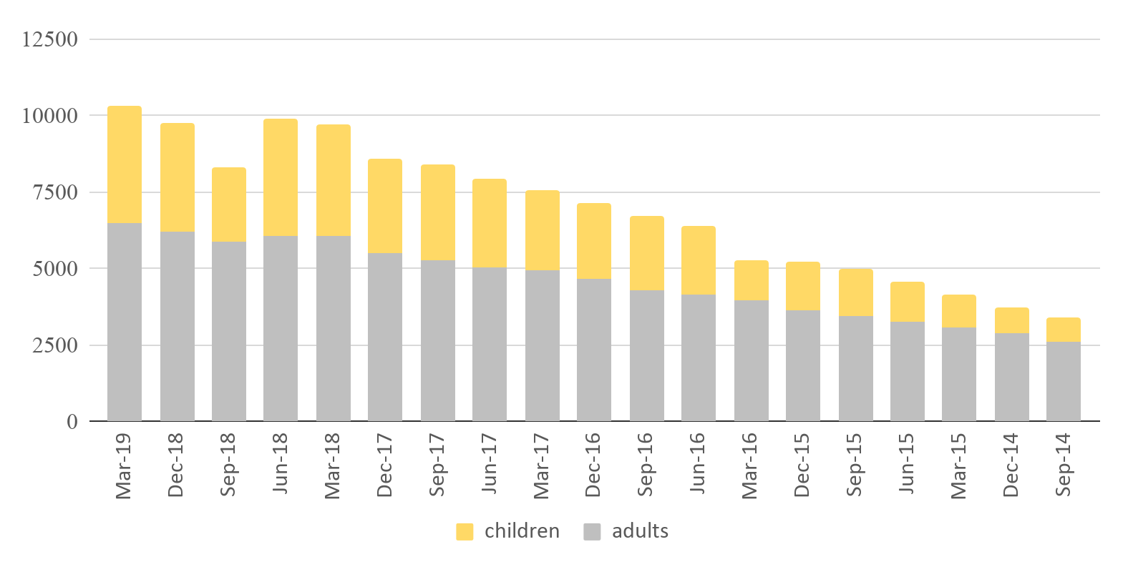
Unprecedented rise in homelessness in Ireland:
150% increase since 2015.
March 2015: 3,081 homeless adults and 1,054 homeless children.
March 2019: 6,484 homeless adults and 3,821 homeless children.
Homeless Children and Adults in Ireland, Sept 2014 - March 2019.
Notes:
Total number of homeless people has increased from 3402 in Sept 2014 to 10,305 in March 2019. Methodology for counting has been changed on several occasions but clear trend is up.

Slide 3
Latest government housing policy published in 2016. Proposes:
Increase in new house building to 25,000 pa
Increased social housing output
Increased use of housing allowances for low income private renters, and
Increased use of housing first in Dublin and extension of its use to other cities.

Slide 4
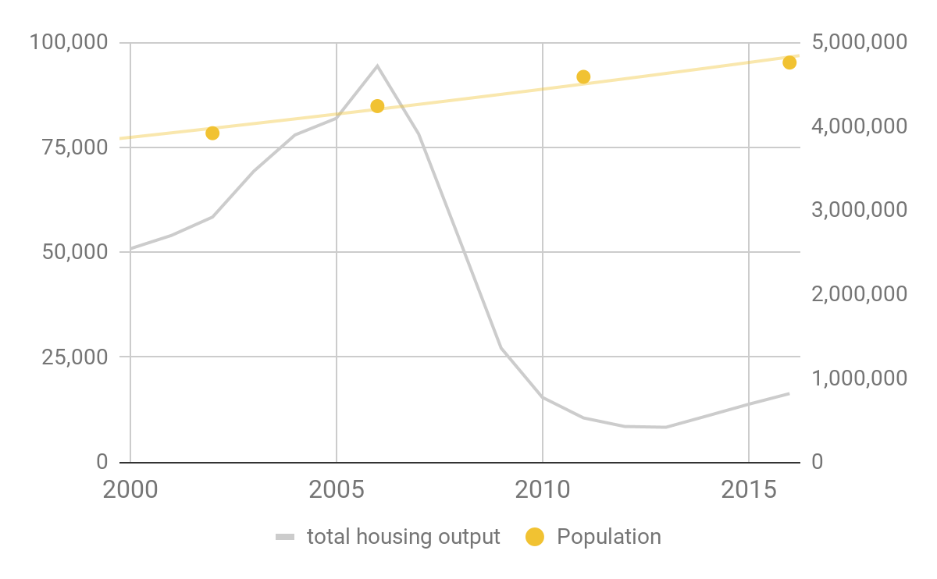
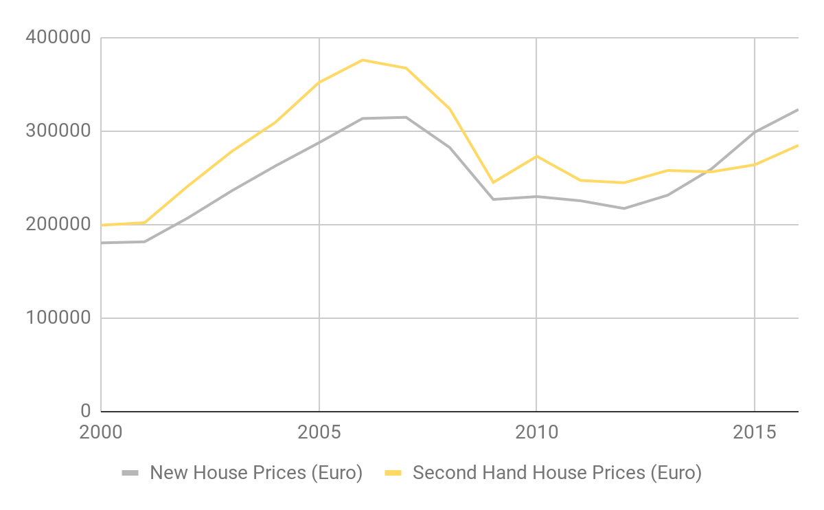
Is more housing the answer? Ostensibly yes.
New Housing Output and Population, 2000-2016.
New and Second Hand House Prices (€), 2000-2016

Slide 5
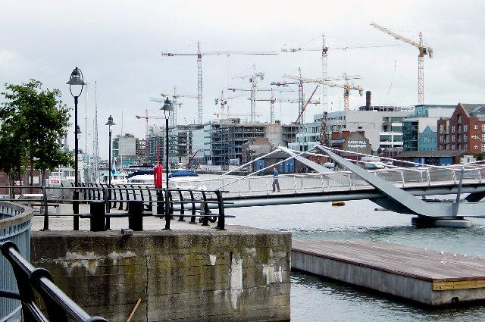
But, the impact which additional supply has on homelessness and housing stress depends on its:
tenure
location and
cost.
All these issues have proved problematic in Ireland

Slide 6
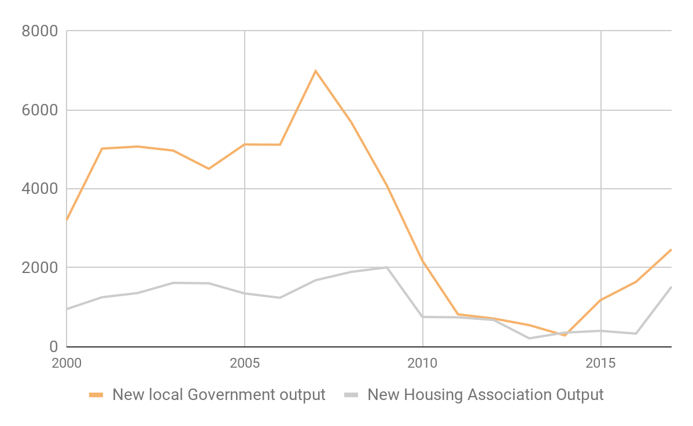
Tenure:
inadequate social housing output:
Sharp cuts in government funding following economic crisis in 2008
Led to significant fall in output.
Although funding has risen increasing again is slow.
Social housing output in Ireland, 2000-2015.
Notes:
Total number of homeless people has increased from 3402 in Sept 2014 to 10,305 in March 2019. Methodology for counting has been changed on several occasions but clear trend is up.

Slide 7
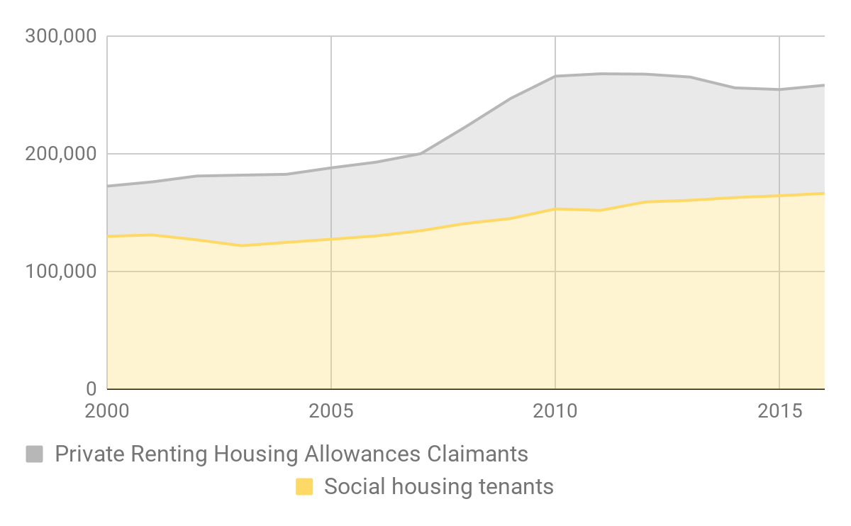
Tenure:
over reliance on housing allowances for private renting tenants:
Inadequate supply of affordable dwellings
High rent inflation.
Most homeless families are evicted from private rented accommodation.
Social housing output in Ireland, 2000-2017.
Notes:
Total number of homeless people has increased from 3402 in Sept 2014 to 10,305 in March 2019. Methodology for counting has been changed on several occasions but clear trend is up.

Slide 8
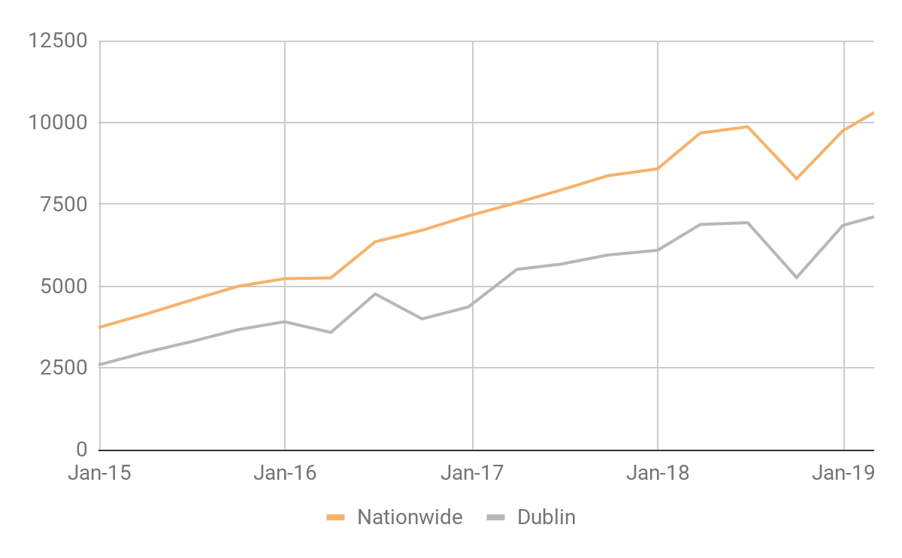
Location:
problem is heavily concentrated in Dublin:
70% of homeless people are in Dublin
Housing unaffordability is particularly acute here.
Homeless People in Dublin and Ireland, Sept 2014 - March 2019.
Notes:
Total number of homeless people has increased from 3402 in Sept 2014 to 10,305 in March 2019. Methodology for counting has been changed on several occasions but clear trend is up.

Slide 9
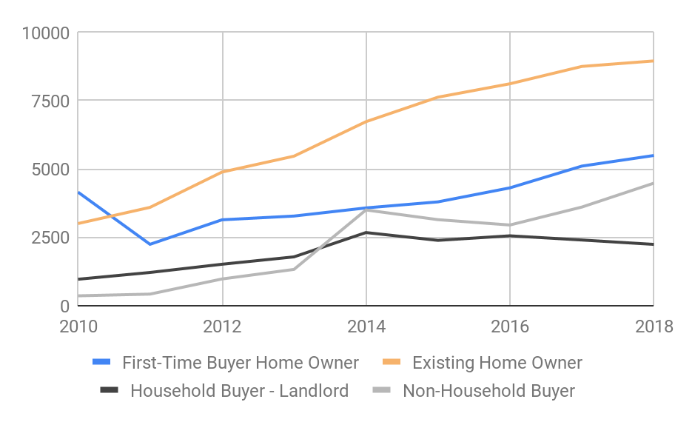
Cost:
Increase in dwelling purchases by non household buyers:
21.1% of purchases in Dublin in 2018, just 4.2% in 2010.
Some are for social housing
Many are REITs, built-to-rent and student housing companies which target the top of the market.
Dwelling Purchases by Volume (N) in Dublin 2010=2018..

Slide 10
Is more housing the answer to Ireland’s current homelessness crisis?
Depends on its:
Tenure: more mainstream social housing is vital.
Location: particularly in cities where housing allowances for private renting tenants are difficult to operate.
Cost: worrying evidence that Ireland’s banking crash redirected new housing supply towards the top end of the market and away from provision of affordable housing to rent and buy.

